Slide 1
FACIAL FEATURE EXTRACTION AND EMOTION ANALYSIS USING SVM & HOG
SAI PRANAV CHITTELLA(943)
PAVAN SABBAVARAPU(942)
MEGHANA S(930)
SOMESWARA RAO(938)

Slide 2
Overview:
The project is aimed to extract the features from the offline facial image dataset and perform Support Vector Machines Classification and Histogram of Oriented Gradients , to extract the emotions. Presented in this project is hybrid feature extraction and facial expression recognition recognition method with a dual classifier approach that uses Viola-Jones Cascade object detectors and Harris key-points to extract features from the images. We are interested in seven fundamental emotions such as Anger, fear, Happiness, Disgust, Sadness, Surprise and Contempt. The project covers discipilines such as Image Processing, Machine Learning and Computer Vision.

Slide 3
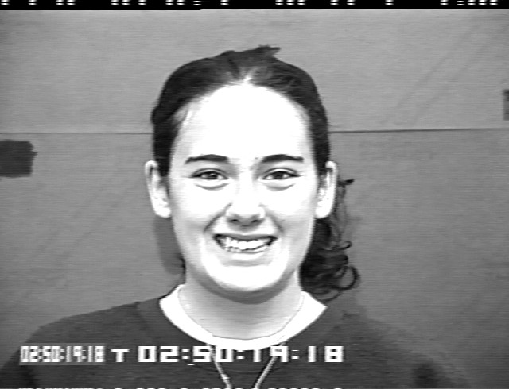
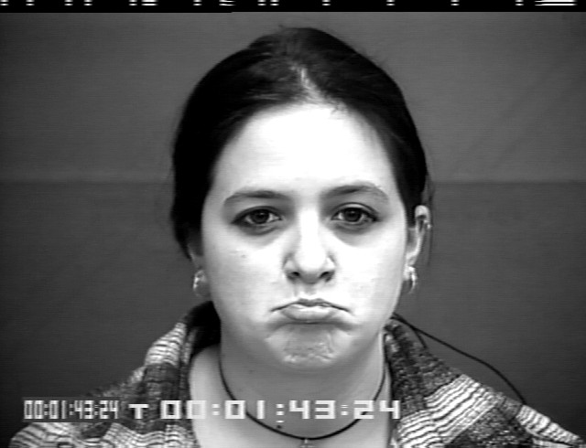
Cohn and Kanade dataset
Facial behavior of 210 adults was recorded using two hardware synchronized Panasonic AG-7500 cameras. Participants were 18 to 50 years of age, 69% female, 81%, Euro-American, 13% Afro-American, and 6% other groups. Participants were instructed by an experimenter to perform a series of 23 facial displays; these included single action units and combinations of action units. Each display began and ended in a neutral face with any exceptions noted. Image sequences for frontal views and 30-degree views were digitized into either 640x490 or 640x480 pixel arrays with 8- bit gray-scale or 24-bit color values

Slide 4
PROJECT DESIGN
Training Module
Testing Module

Slide 5
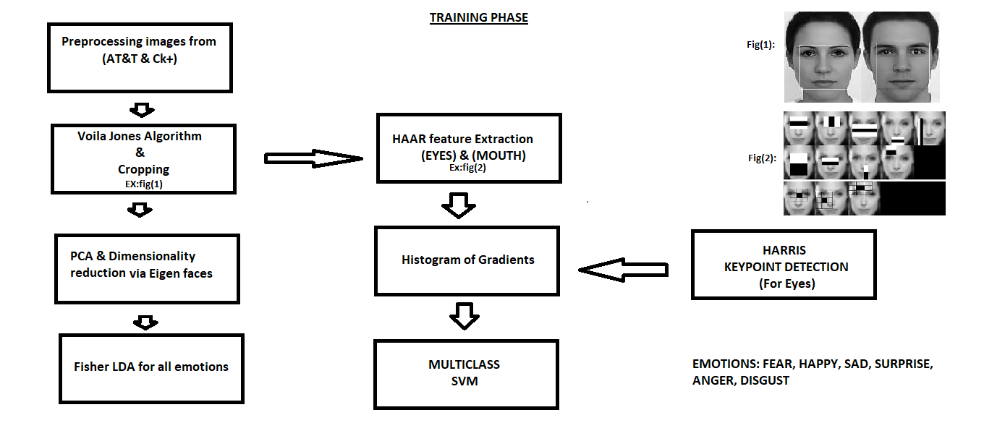
TRAINING MODULE

Slide 6
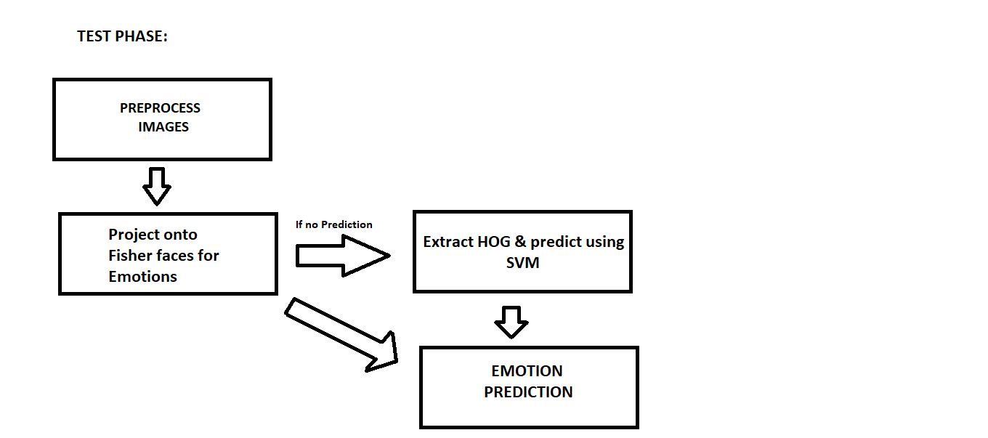
TESTING MODULE

Slide 7
Viola – Jones Algorihtm (for face detection and cropping)

Slide 8
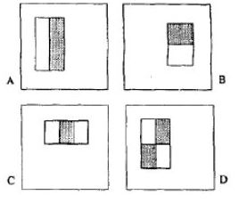
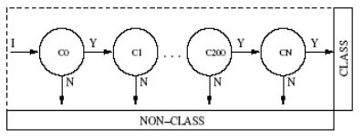
The Viola-Jones detector is a strong, binary classifier build of several weak detectors

Slide 9
CROPPING FACES and INITIAL TRAINING

Slide 10
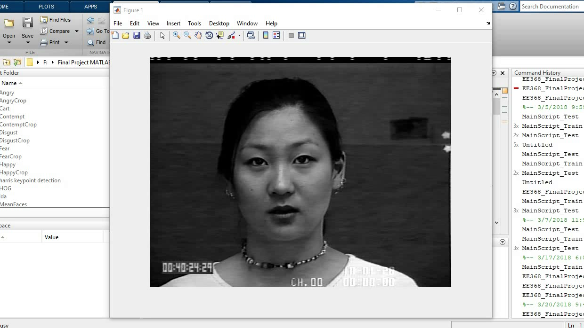

Slide 11
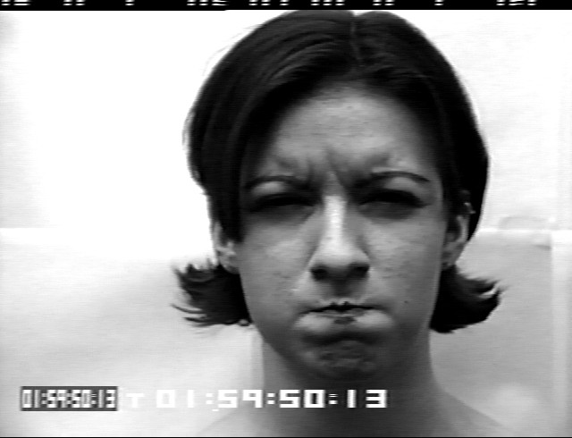

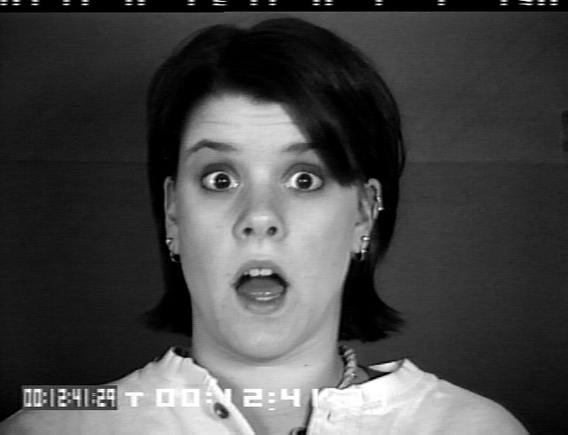

Results of Viola Jones Algorithm

Slide 12
Principal Component Analysis

Slide 13
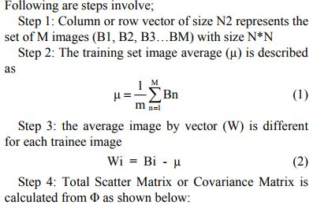
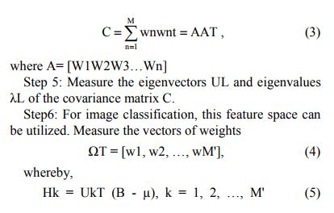
Eigen Faces for Detection

Slide 14
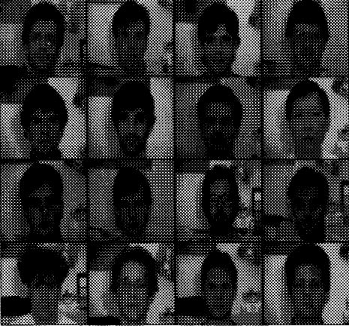
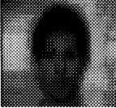
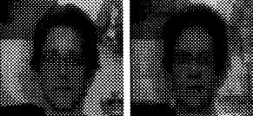
Faces (Mean Face and Eigenfaces)
Mean Face
Eigen faces
Set of random face images for training

Slide 15
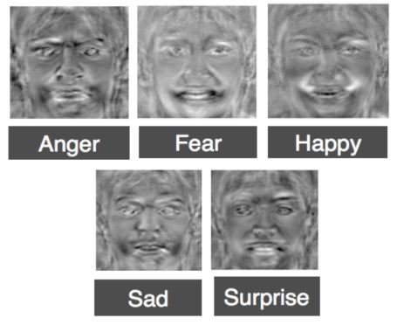
Results(Eigen Faces):

Slide 16
Fisher’s Linear Discriminant Analysis

Slide 17
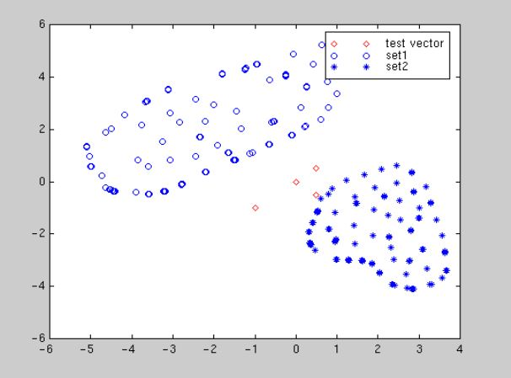

Slide 18
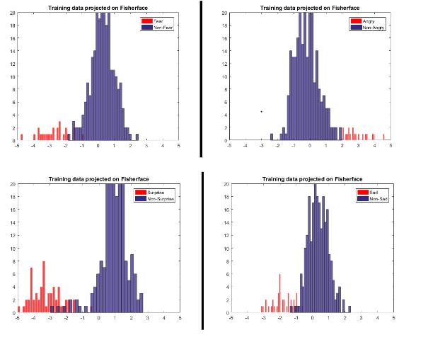
Projecting all the training images onto the individual fisher’s faces:

Slide 19
Histogram of Oriented Gradients
And
Support Vector Machines

Slide 20
Histogram of Oriented Gradients:
A feature descriptor is a representation of an image or an image patch that simplifies the image by extracting useful information and throwing away extraneous information.
In the HOG feature descriptor, the distribution ( histograms ) of directions of gradients ( oriented gradients ) are used as features. Gradients ( x and y derivatives ) of an image are useful because the magnitude of gradients is large around edges and corners ( regions of abrupt intensity changes ) and we know that edges and corners pack in a lot more information about object shape than flat regions.
The feature vector produced by these algorithms when fed into an image classification algorithms like Support Vector Machine (SVM) produce good results.

Slide 21

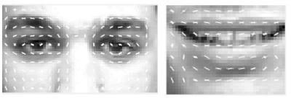
HOG Descriptor
HOG Result:

Slide 22
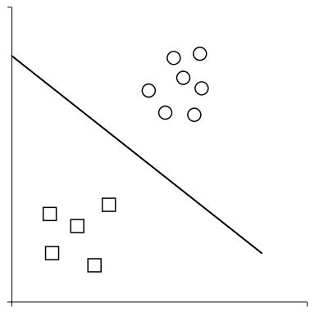
Support Vector Machines
A Linear Classifier is shown below:

Slide 23
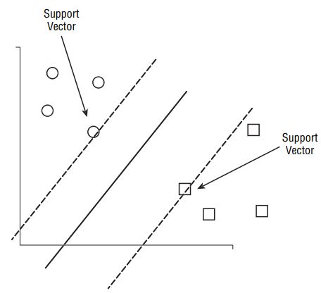

Slide 24
Results

Slide 25
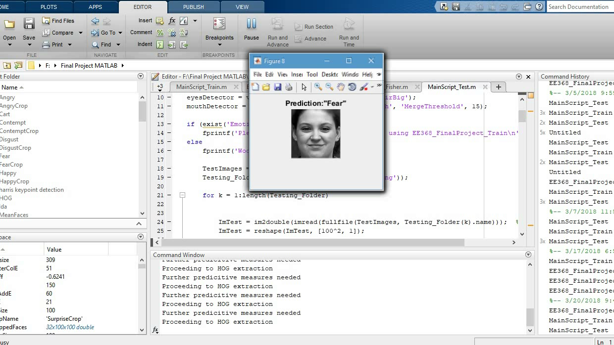
The dual classifier approach is tested on 32 test images.

Slide 26
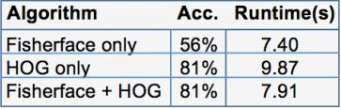
The dual-classifier approach works well when the Fisherface cannot effectively determine a prediction. This happens in two cases. First is if a test image is not one of the “easy-to-distinguish” emotions, and second is if the Fisherface classifier cannot decide between two or more predicted emotions.
When using the HOG and SVM classifier only, the accuracy for detection is 81%, much better than a Fisherface only approach. When using the dual-classifier method, the accuracy is the same as HOG-only at 81%, but the testing process is 20% faster

Slide 27
THANK YOU!

